Slide 1
From Roller Coasters to Assessment Timepocalypse
Roger Saunders
Associate Professor – University Teacher Fellow
roger.saunders@dmu.ac.uk

Slide 2
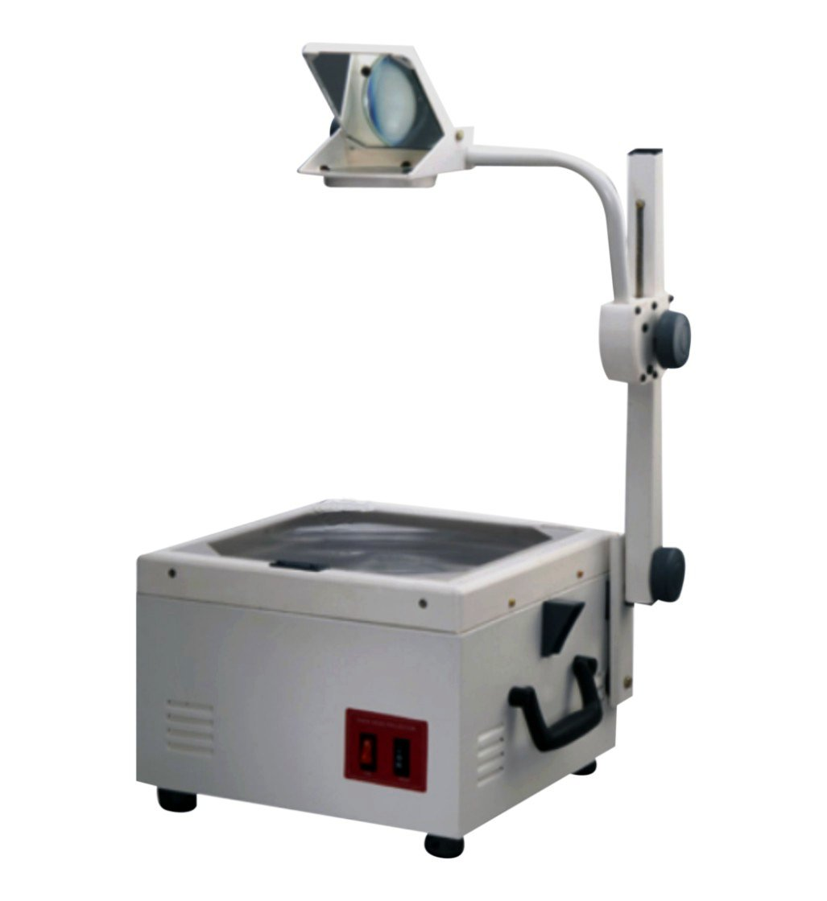
In the beginning…

Slide 3
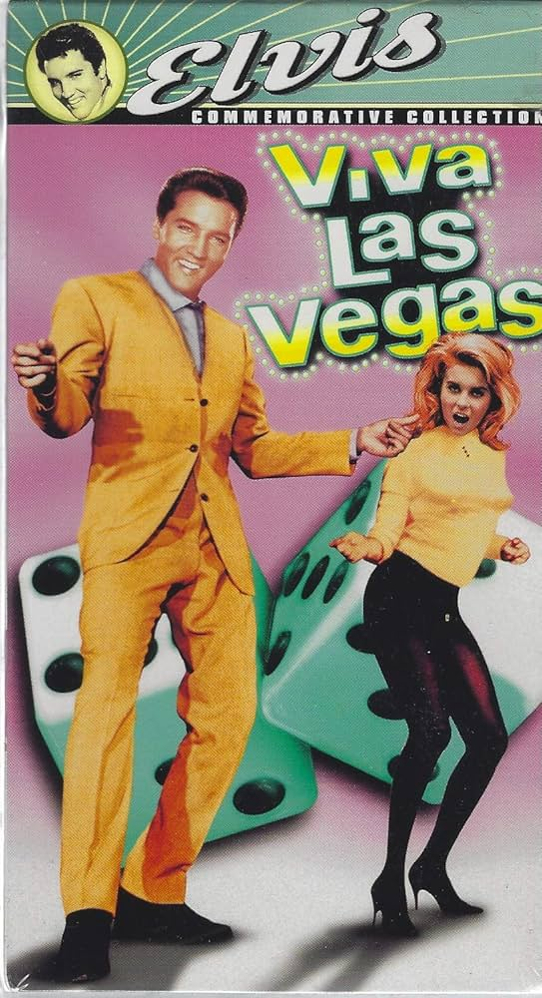
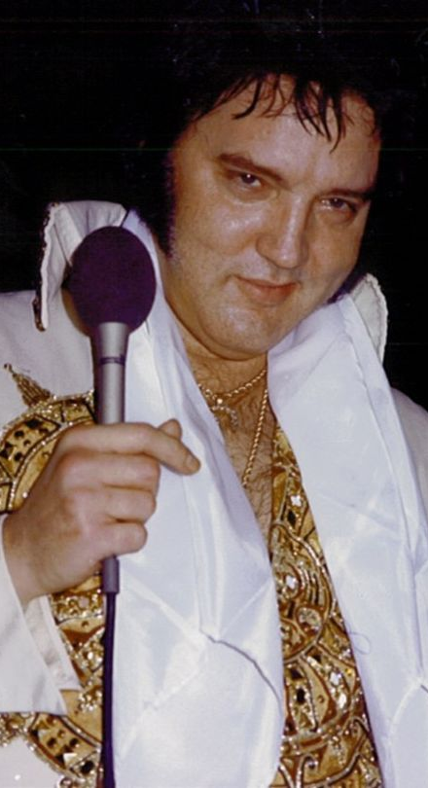
Making ideas visual
With thanks to Brian Wheeler – Birmingham University

Slide 4
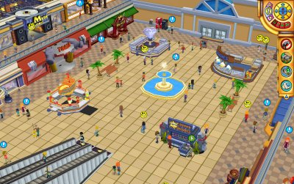
A long
time ago
in a classroom
far, far away

Slide 5
A teaching philosophy
What is the point of lectures?

Slide 6
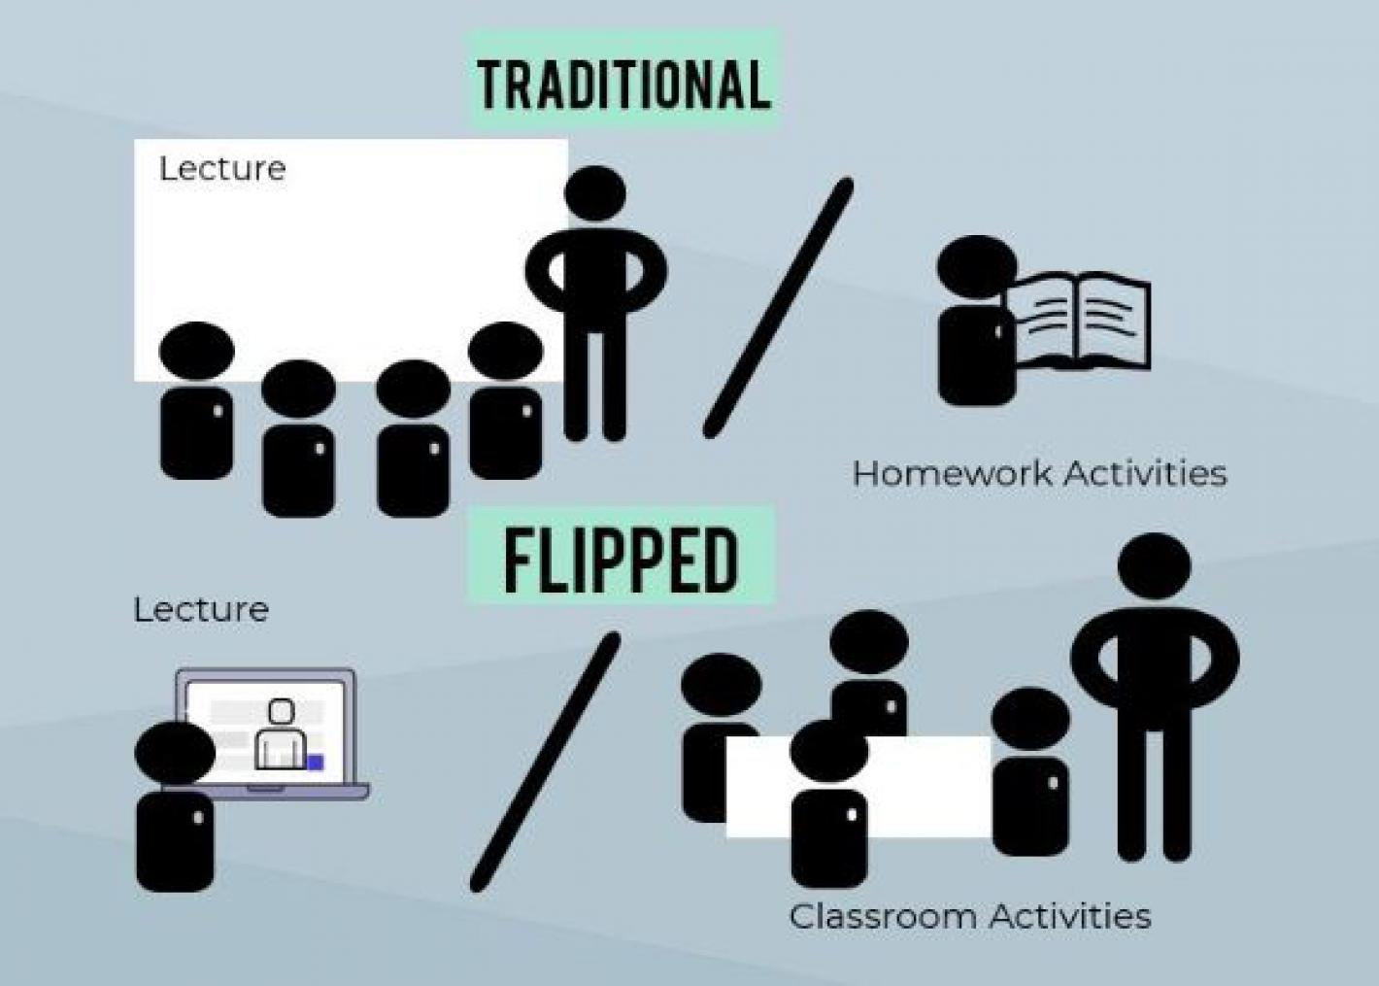
Time on task
With thanks to Graham Gibbs – Retired Reader University of Huddersfield

Slide 7
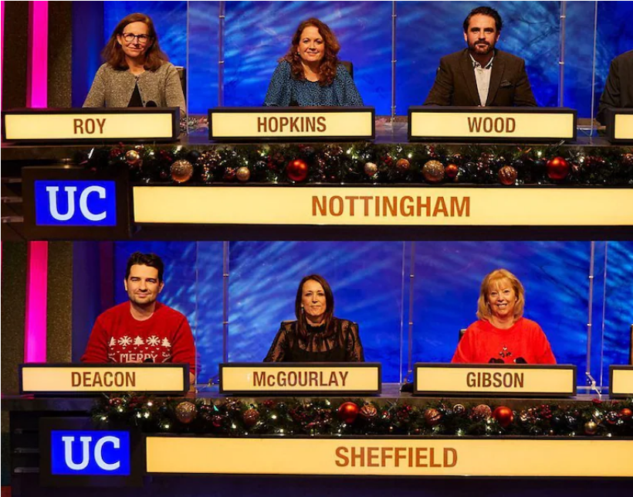
Making tests fun

Slide 8
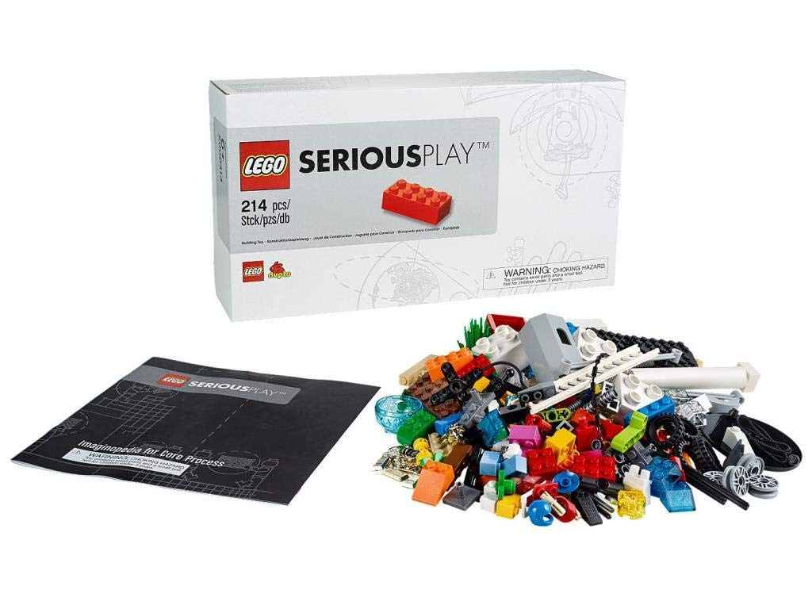
Imagination
With thanks to Roz Sunley – Winchester Business School

Slide 9
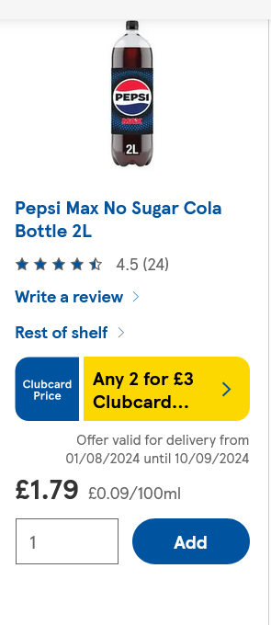
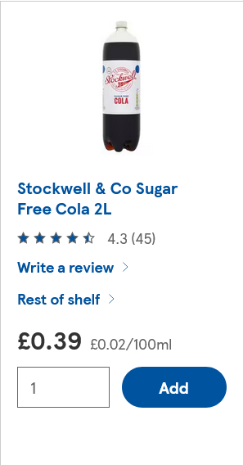
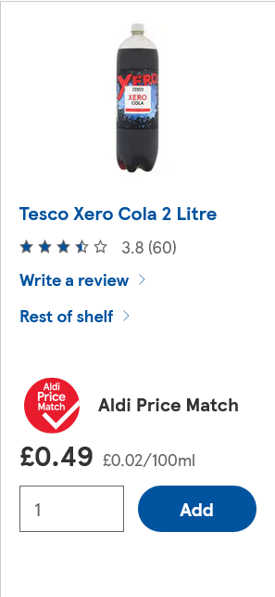
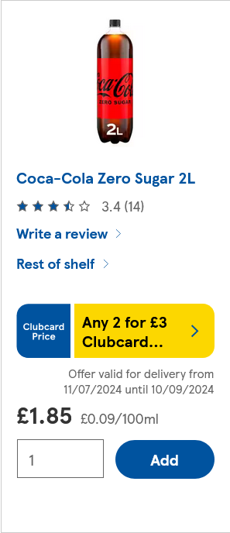
Sensory learning - taste
A Pepsi Max
B Stockwell
C Tesco Xero
D Coke Zero

Slide 10
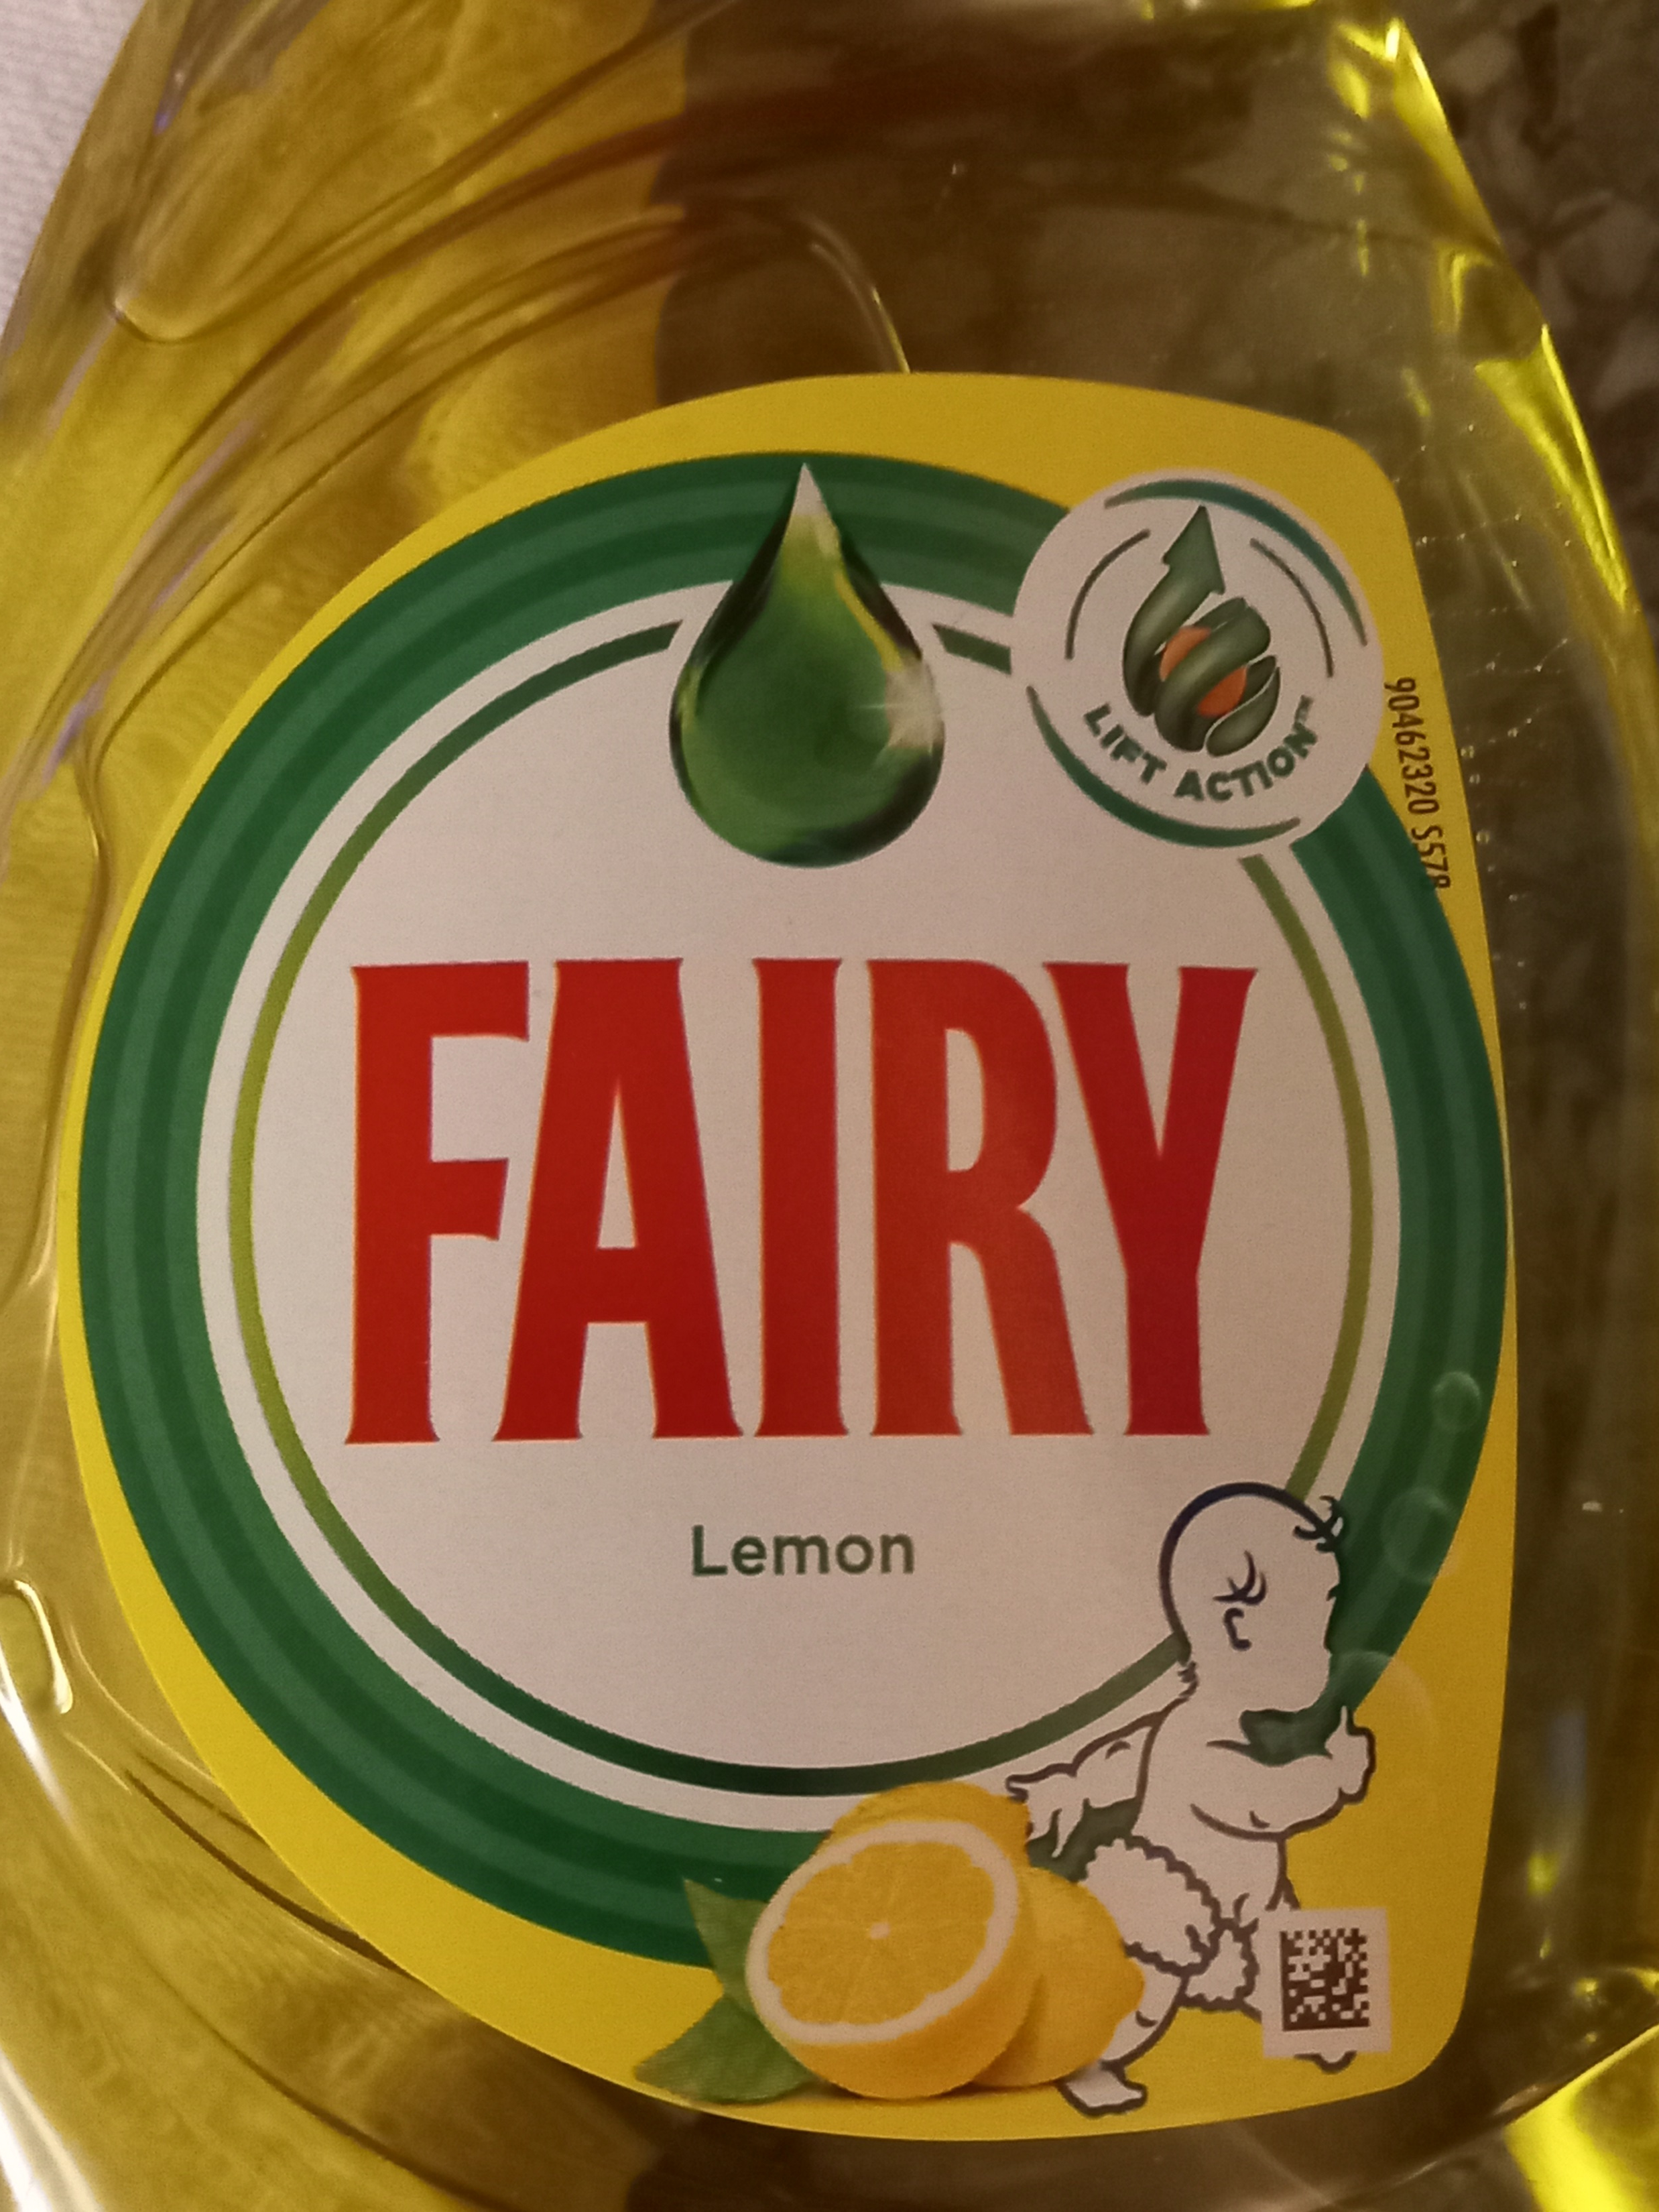
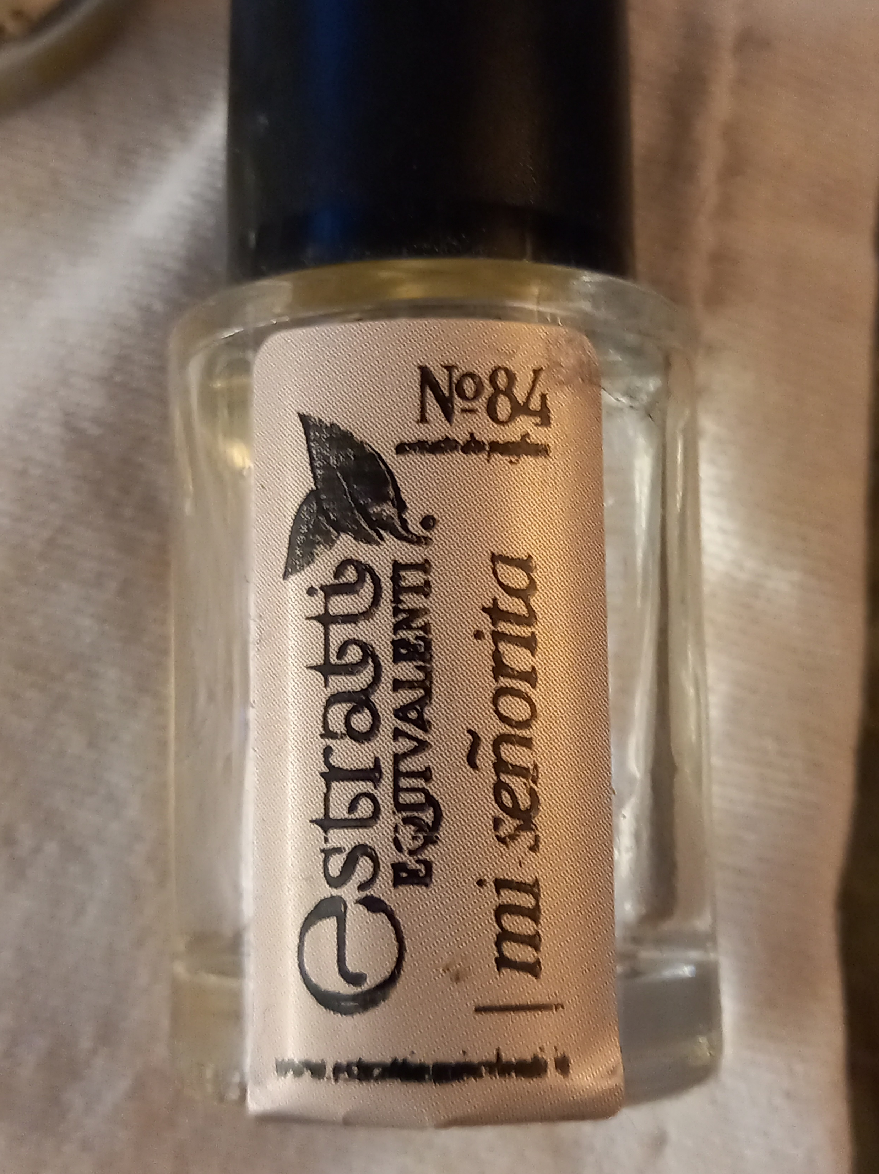
Sensory learning - smell
A B
C D

Slide 11
Sensory learning - sound

Slide 12
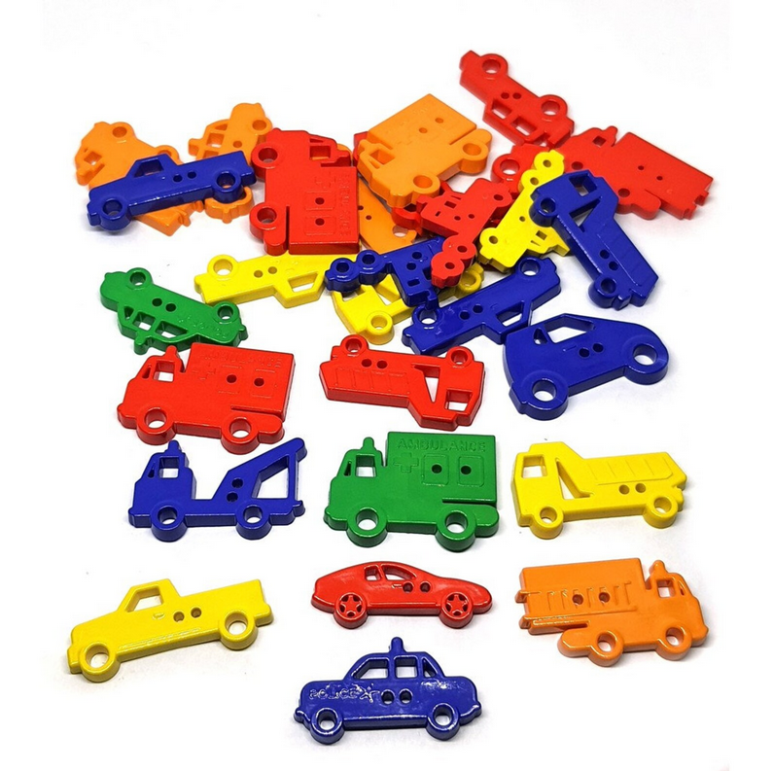
Sensory learning - touch

Slide 13
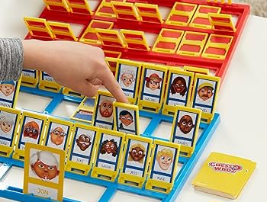
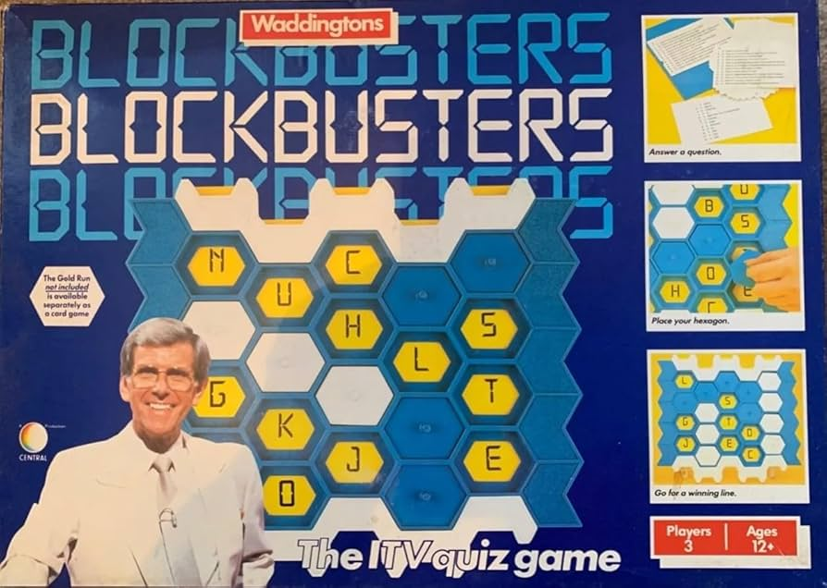
Board games/card games

Slide 14
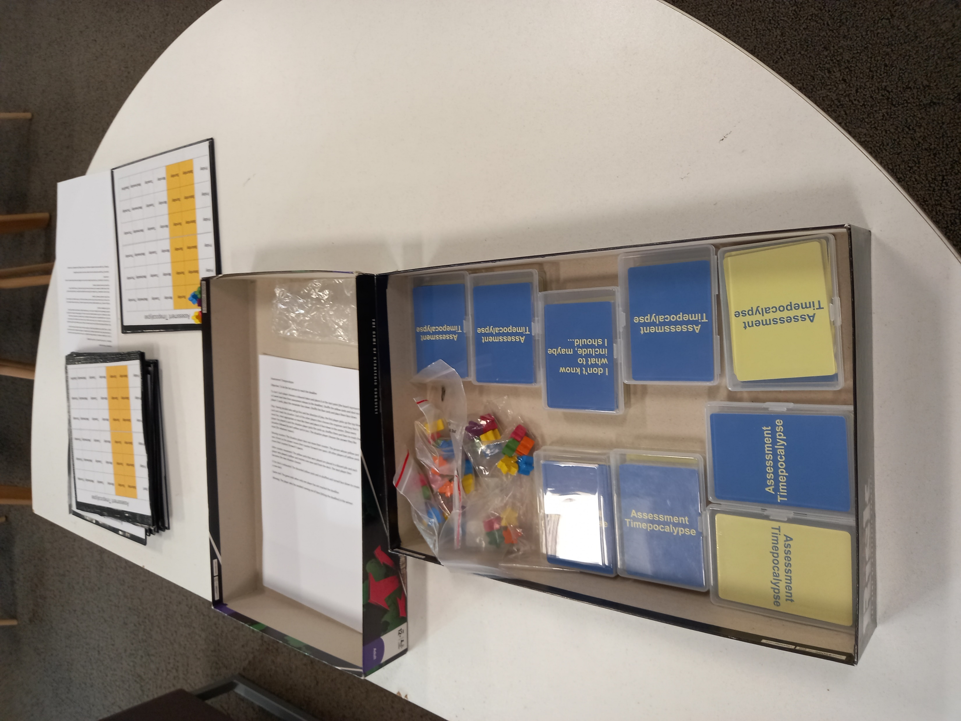
Assessment Timepocalypse

Slide 15
Thank you
Roger Saunders
roger.saunders@dmu.ac.uk
L&T Chat Show on Spotify

